Slide 1

Realtime Object Detection and Classification

Slide 2
Project Members
Arbaz Ahmed Khan (Roll No. 25500118057)
Aswini Kumar Sahoo (Roll No. 25500118054)
Chandrima Roy (Roll No. 25500118050)
Kishor Yadav (Roll No. 25500118039)
Rishabh Raj Gupta (Roll No. 25500118027)
Under the Guidance of Mr. Anjan Kumar Payra

Slide 3
Overview
An object detection solves two subsequent tasks:
Detecting possible object regions
Classifying the image in those regions into object classes

Slide 4
Tools and Libraries Used
Tools :
Libraries :
Android Studio
Figma
Github
CameraX (API)
MLKit (API)
MobileNet V3 (External Classifier)

Slide 5
Related Works
Object Detector by AnhNguyen
This app has 2 modes :
● Detection mode ● Classification mode
It uses the YOLO model for object detection.

Slide 6
Related Works
Google Lens
As of now, Google lens can detect multiple objects from the image, but it does all the operations of detection and classification after the image is being clicked by the user on the smartphone. It does not provide the feature of real-time object detection.

Slide 7
Modes
The application comes with 3 modes for providing flexibility in terms of usage.
Still Image
Capture
Realtime

Slide 8
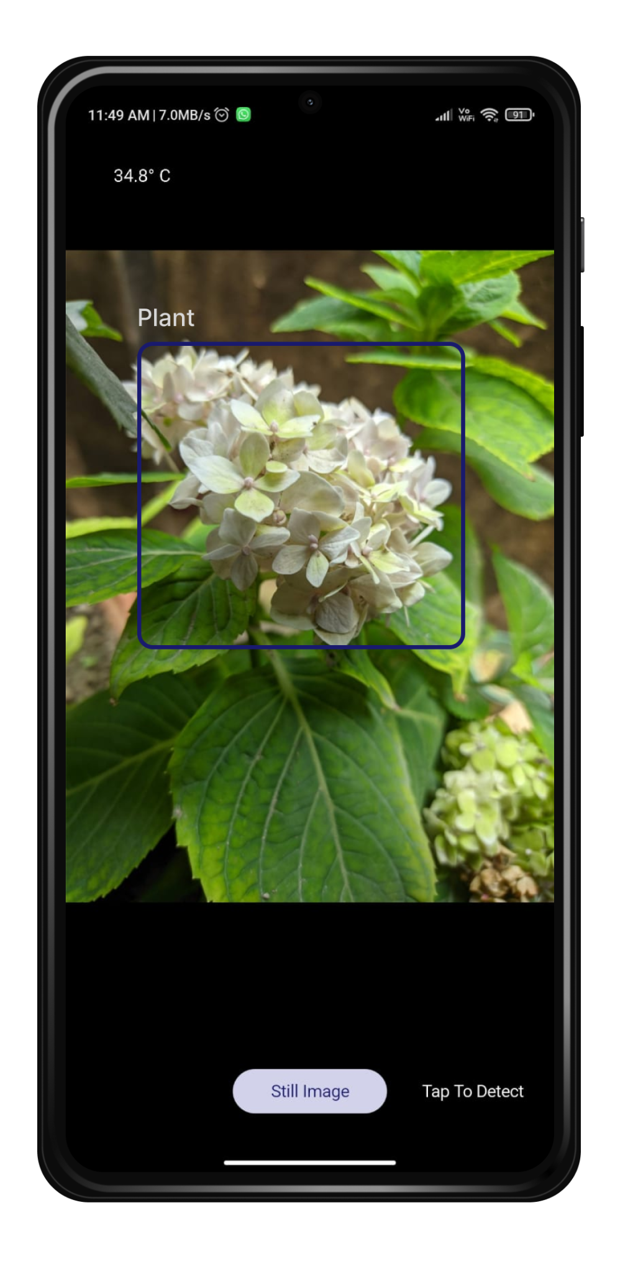
Still Image
This mode allows users to select images from the file system present in the mobile device.

Slide 9
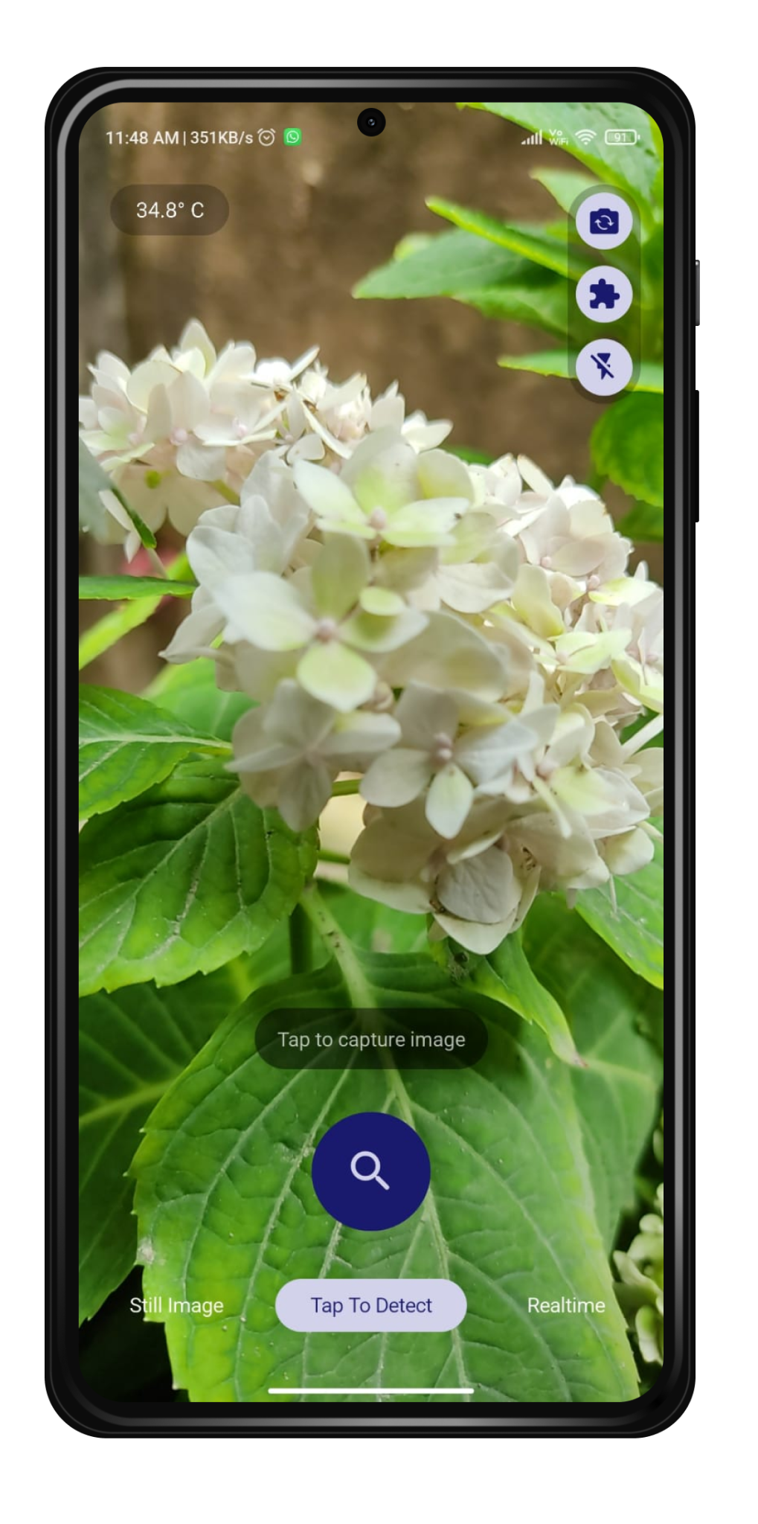
Capture
This mode allows users to capture images using the button provided.

Slide 10
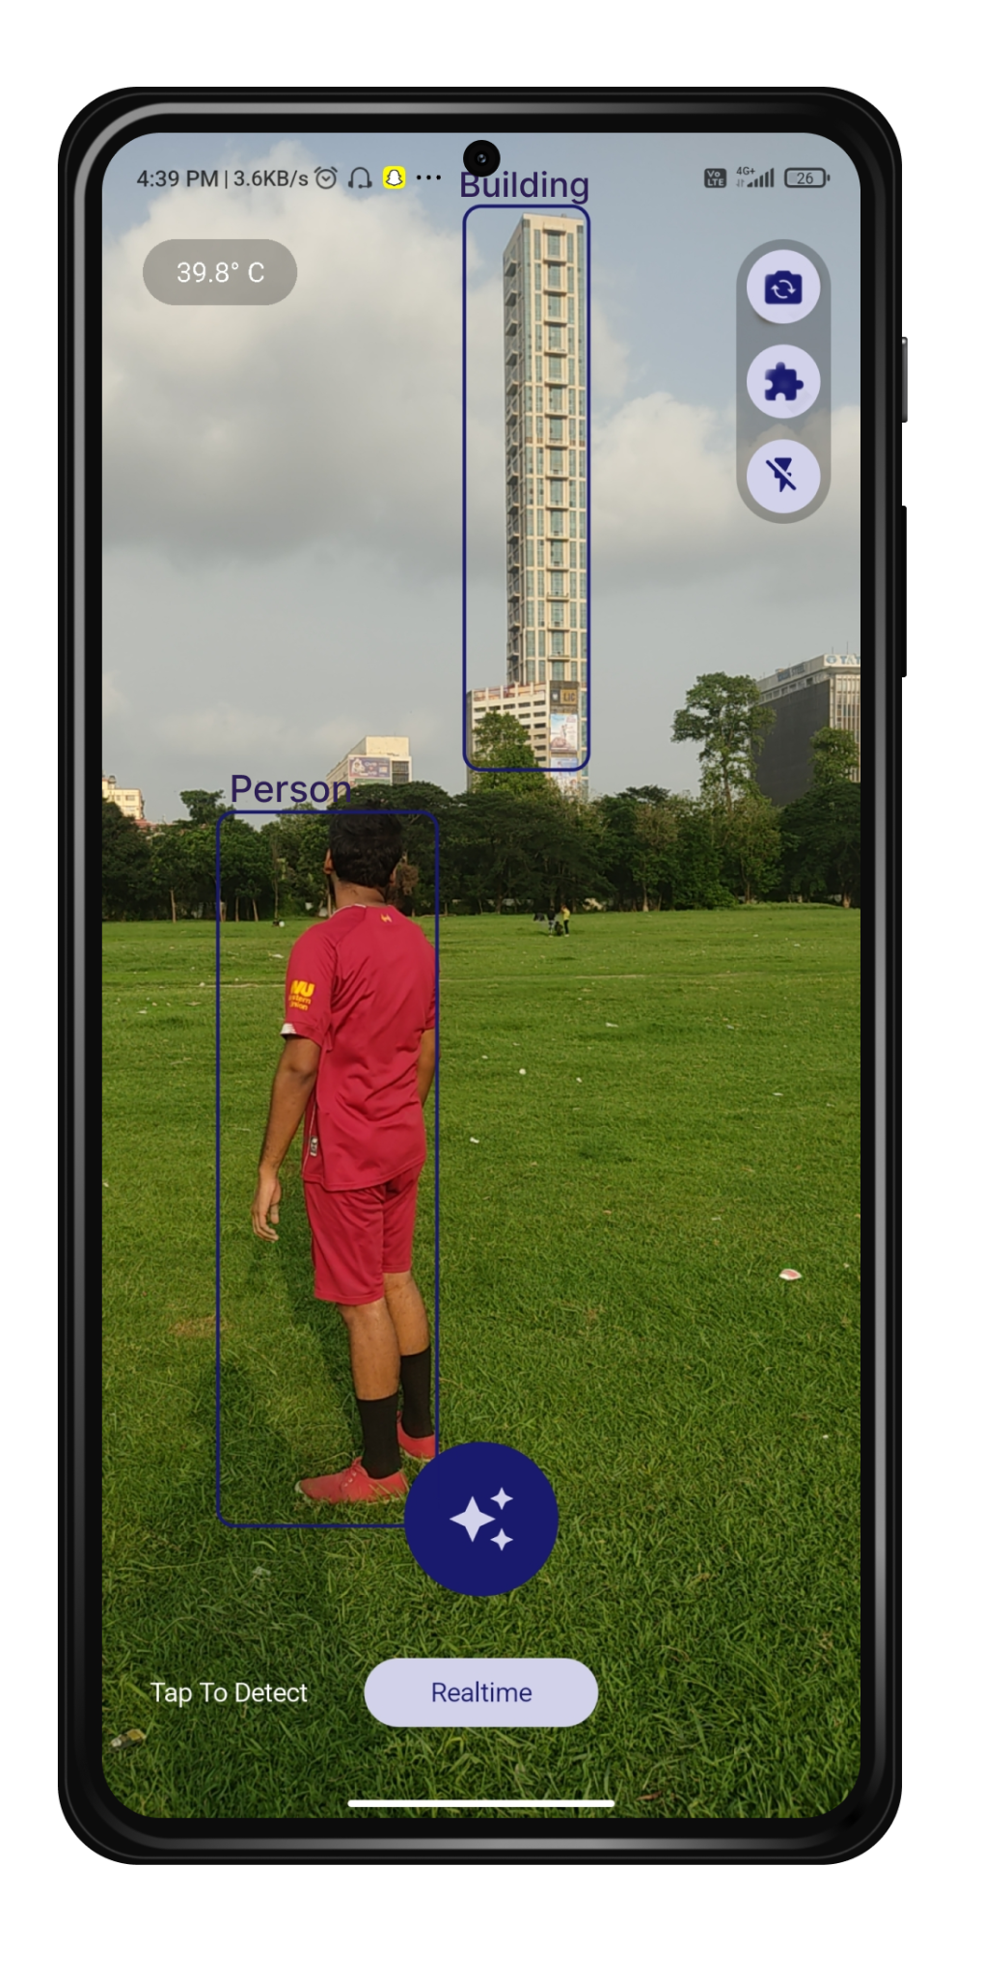
Real-Time
This mode allows users to detect and classify objects in real-time.

Slide 11
Working Principle
The working principle can be broken down into three steps :
Getting frames using CameraX API.
Passing the frames to ML Kit API.
The output label received from ML Kit API is then transferred to an External classifier , where classification of objects is being done at a narrow level.

Slide 12

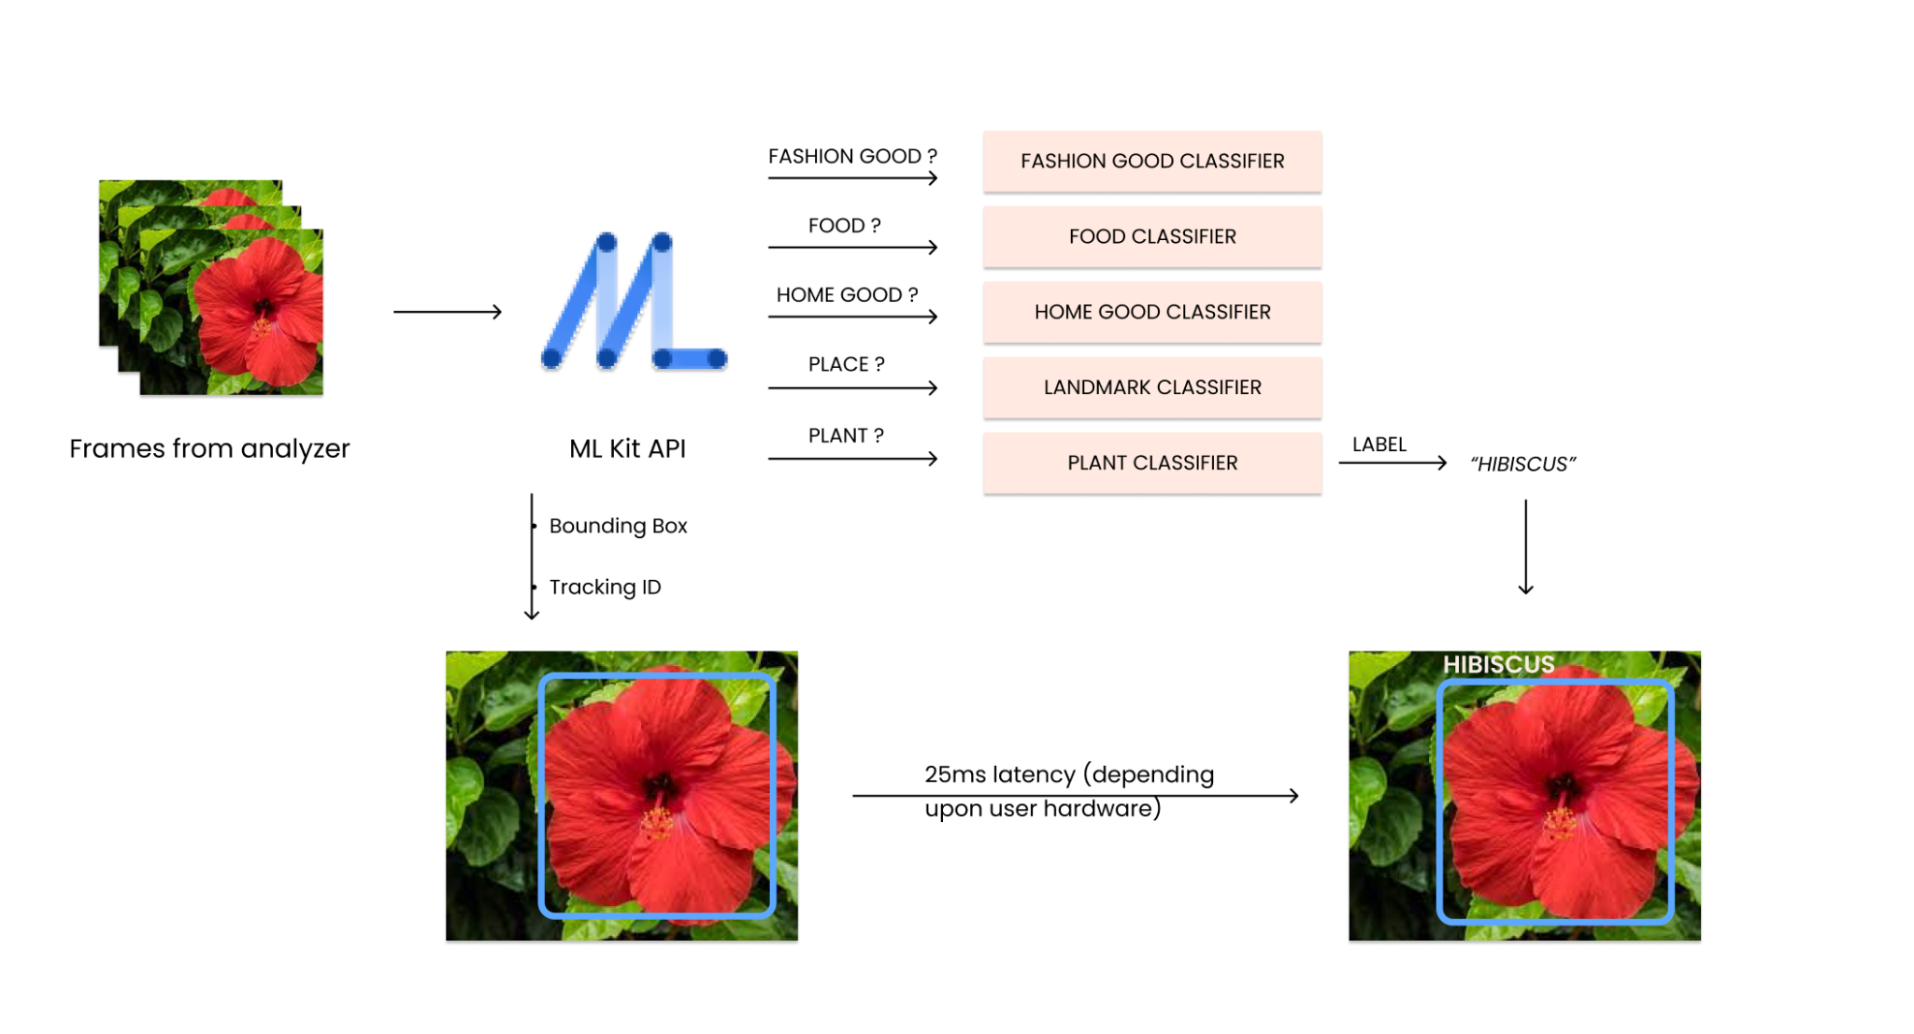
Working Principle

Slide 13
Working Principle

Slide 14
Working Principle

Slide 15
Working Principle

Slide 16
Working Principle

Slide 17
Working Principle

Slide 18
USP
Object detection done on mobile-device itself
Live tracking and detection of objects
Detect multiple objects with decent accuracy
Detect a wide range of objects
Provide seamless user experience

Slide 19
Limitations
Delay between the object’s detection and its classification.
Apk bundle size is larger.

Slide 20
Future Scope
Optical Character Recognition
Inclusion of TalkBack feature
Translation of languages of any sort of text detected

Slide 21
Thank You!

